Slide 1
Genetic Algorithm, PMF
Kuan Sao I
29th Aug 2019

Slide 2
[1] Genetic algorithm - hybrid - cold start
[1] built a recommendation system in e-commerce applications using the hybrid approach. The main contribution is employing the Genetic Algorithm (GA) to learn the personal preferences of customers.
1- Product features, customer transaction history, and customers’ general information.
2- Use product profiles, customer transactions, and customers’ general information to build user preferable profiles. Select the most similar neighbors based on the user’s preferable profile. Recommend products for the customer based on neighbors’ selections.
3- They only satisfy one stakeholder who is the user.
4- A product profile is presented by several features. The customer’s product preference profile is built from the customer transaction data and the product profile. The GA is applied to find the feature weighting for a customer. Products are recommended to users by using a collaborative filtering approach.
Notes:
Feature-based recommendations for one-to-one marketing.

Slide 3
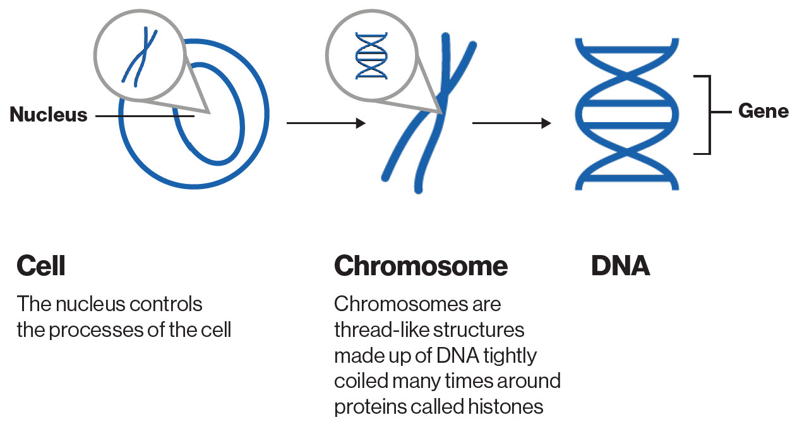
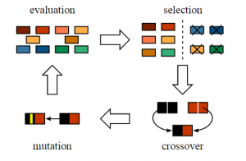
GA

Slide 4

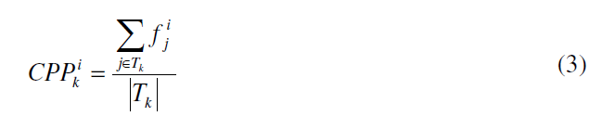
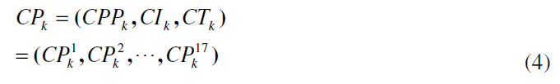
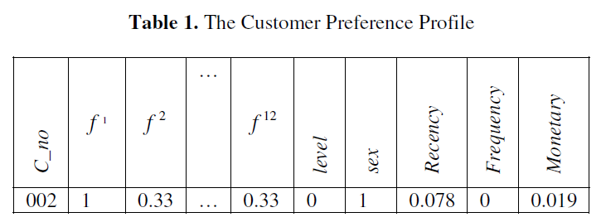


Extract chromosomes
product profile: its feature values, defined as a binary vector, where n is the number of product features (n=12, in our experiment.).
product preference profile:Represents the preference profile of feature i for customer k and is obtained by summing up the feature information from the products purchased by customer k.
the set of products purchased by customer k
contains customer k’s information including member level and gender
contains the information about customer k’s purchasing behavior measured by RFM (recency, frequency, and monetary)

Slide 5

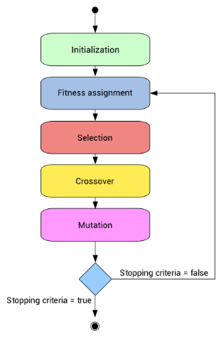
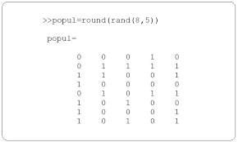
Extract chromosomes
The chromosome in the GA process is represented as a weight vector with 17 genes.
Each gene is encoded with 8 bits. The GA begins with random genotypes and an initial population of 100 chromosomes.
The GA begins with random genotypes and an initial population of 100 chromosomes.
Wk is the feature weights of customer k obtained fromGAs.
w1 w2 … w12 w13 w14 w15 w16 w17
0
0
0
0
0
0
0
1
0
0
0
0
0
1
1
1
Roulette wheel
selection
8bit
...x 100

Slide 6
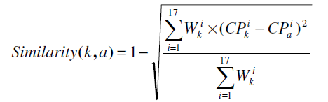
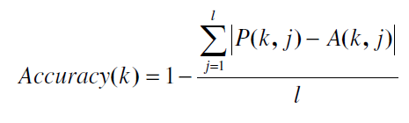

Train set and Test set
Fitness function
Best feature weights
Each active customer k is tested by a random selection of l products.
P(k, j) : the predicted ratings of customer k to product j
By CF -Knn
A(k, j) : the actual ratings of customer k to product j
Select the most similar n neighbors (denoted as k NB ) by computing the similarity value.
Roulette wheel
selection

Slide 7
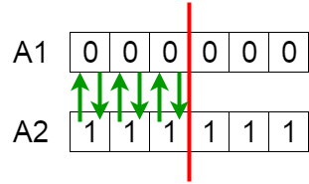
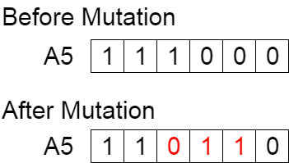
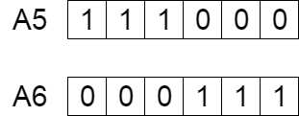
Crossover & Mutation
Crossover
Mutation
Recommendation
purchase(i ,j): is set to 1 if customer i has purchased product j, 0 otherwise.
Score(k, j): active customer k, each product j.

Slide 8
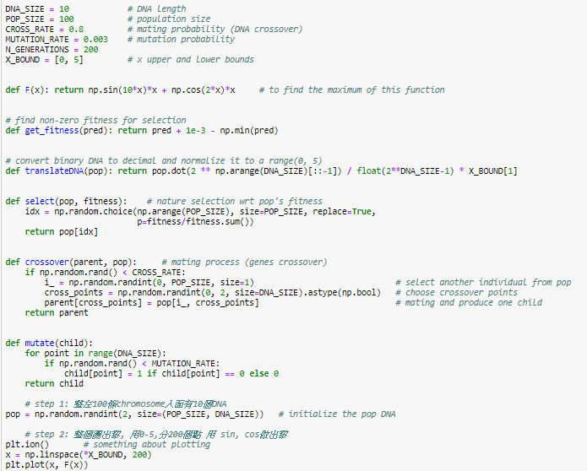
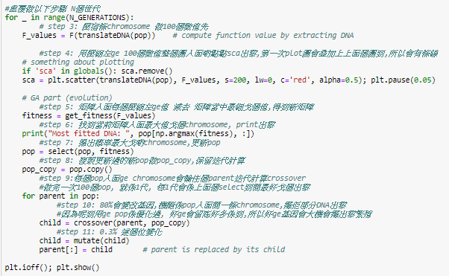
GA on ipynb

Slide 9
[2] - user-base collaborative
[2] built a news recommendation system by using user-based collaborative approach. The main contribution is utilizing experts’ opinions to solve the cold start problem.
1- The reader’s history and the reader’s implicit rating—which reflects if the reader opens the story or not - are used.
2- From the reader history, find his preference profile. Find experts who influence the reader. Incorporate the reader’s preferable factors from preference profile with the experts’ opinion to recommend news stories to the reader.
3- They only satisfy one stakeholder who is the news reader.
4- User interest is represented by preferable entities. Then they use it to create user-entity matrix. They use users’ news story access history to create a user-story matrix, which is sparse due to the large amount of news stories. To solve that, they predict the missing story rating by using a user-entity matrix. Moreover, they find experts based on the reading time order. Finally, they recommend news stories based on all of the above.
Notes:
PRemiSE

Slide 10

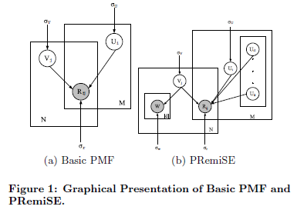


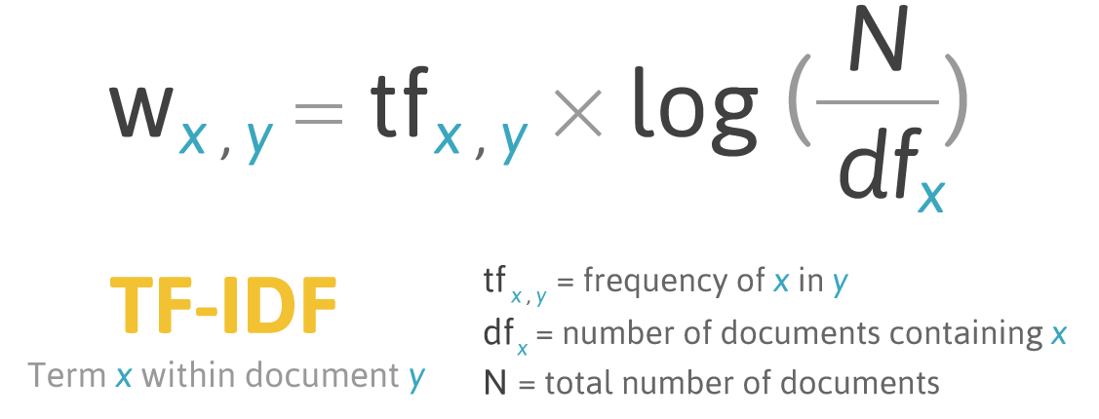
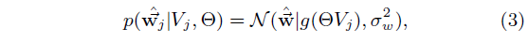
PRemiSE
w1 : effect of collaborative filtering
w2 : effect of “word of mouth”
w1 + w2 = 1.
Note that w1 and w2 are dynamic parameters.
ρe,i : influence relationship between “experts” Ue and user Ui
Vj : item
Ui : user
Ue : expert user
w1 : effect of collaborative filtering
w2 : effect of “word of mouth”
ρe,i : influence relationship between “experts” Ue and user Ui
ρe,φ : influence relationship between “experts” Ue and user New Ui
Θ : word space
θw,k : the strength of word w correlating with factor k
Probabilistic expression of PRemiSE:

Slide 11
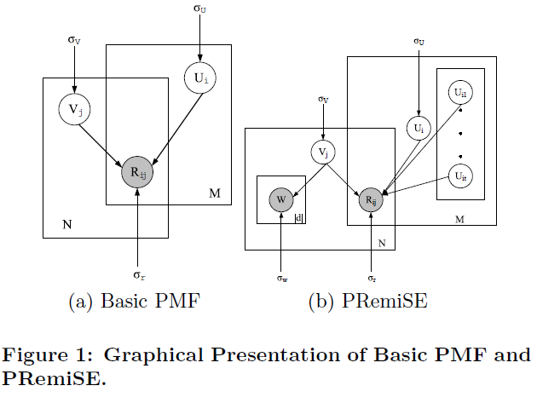
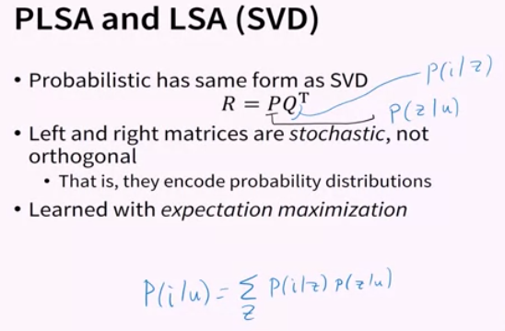
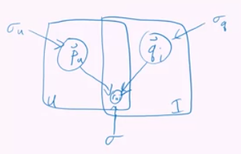
PMF
Probability that the user select item i .
Random pick up User in set Z
[2] PRemiSE, [6] Mturk, [23] TaskRec
Notes:
https://zh-tw.coursera.org/lecture/matrix-factorization/probabilistic-matrix-factorization-Eoyiz

Slide 12





PRemiSE
1. Existing Item by Existing User:
2. Existing Item by New User:
3. New Item by Existing User:
4. New Item by New User:
Vj : item
Ui : user
Ue : expert user
w1 : effect of collaborative filtering
w2 : effect of “word of mouth”
ρe,i : influence relationship between “experts” Ue and user Ui
ρe,φ : influence relationship between “experts” Ue and user New Ui
Θ : word space
θw,k : the strength of word w correlating with factor k

